Slide 1

SARA
Record and Replay for Android
Jiaqi Guo†, Shuyue Li†, Jian-Guang Lou‡, Dongmei Zhang‡, Zijiang Yang§, and Ting Liu†
† Xi’an Jiaotong University, China
‡ Microsoft Research Asia, China
§ Western Michigan University, USA

Slide 2

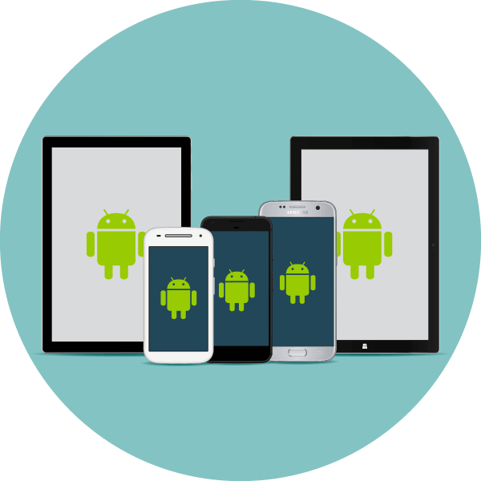
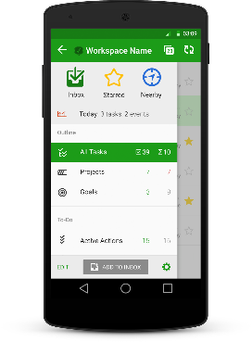
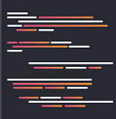


Functionality of Record & Replay
Recording Phase
Replaying Phase
Developer/Testers
Replay Script
Recording Device
Replaying Devices

Slide 3
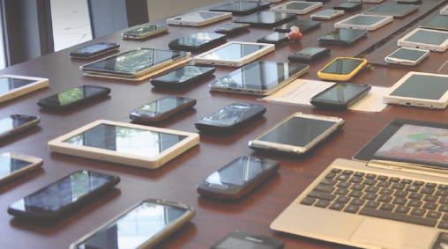
Functionality of Record & Replay
Recording Phase
Replaying Phase
Allow developers to test apps on different devices at once
Fragmentation of Device and OS
Developer/Testers
Replay Script
Recording Device
Replaying Devices

Slide 4
Functionality of Record & Replay
Recording Phase
Replaying Phase
Allow developers to test apps on different devices at once
Fragmentation of Device and OS
Developer/Testers
Replay Script
Recording Device
Replaying Devices
Automate the process of Regression Testing

Slide 5

Recently, features and constraints from WeChat development team have been proposed

Slide 6

Recently, features and constraints from WeChat development team have been proposed
Desired Features
Constraints in practice
Sensitive to Coordinate
Sensitive to Widgets
Sensitive to Timing
Insensitive to State
No custom OS
No instrumentation on app
No root access
No source code

Slide 7
Challenges in Providing all features
under constraints

Slide 8
Challenges in Providing all features
under constraints
Recording and Replaying Rich Sources of Inputs
No Source Code and Custom OS

Slide 9
Challenges in Providing all features
under constraints
Recording and Replaying Rich Sources of Inputs
No Source Code and Custom OS
Efficiently Recording Motion Events Based on Widgets
Recording the widgets under interaction usually introduces large time overhead

Slide 10
Challenges in Providing all features
under constraints
Recording and Replaying Rich Sources of Inputs
No Source Code and Custom OS
Efficiently Recording Motion Events Based on Widgets
Recording the widgets under interaction usually introduces large time overhead
Replaying Events on Different Devices
There are alternate UI layouts and UI resources for different
screen resolutions and sizes

Slide 11
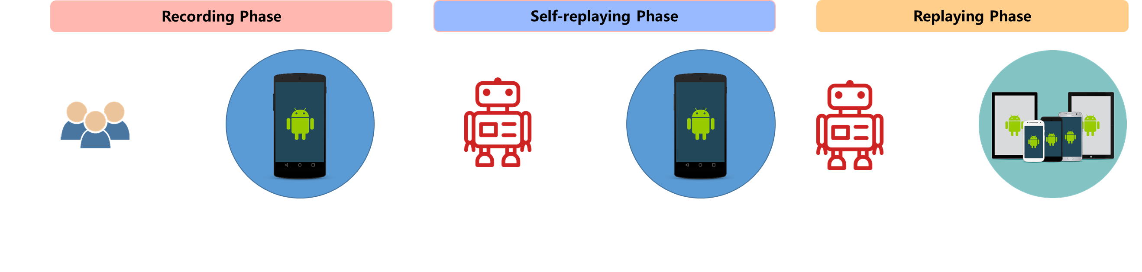
SARA

Slide 12
SARA
Recording and Replaying Rich Sources of Inputs
Technique: Dynamic Instrumentation

Slide 13
SARA
Recording and Replaying Rich Sources of Inputs
Technique: Dynamic Instrumentation
Efficiently Recording Motion Events Based on Widgets
Technique: Self-replay mechanism

Slide 14
SARA
Recording and Replaying Rich Sources of Inputs
Technique: Dynamic Instrumentation
Efficiently Recording Motion Events Based on Widgets
Technique: Self-replay mechanism
Replaying Events on Different Devices
Technique: Adaptive replay method

Slide 15
Evaluation of SARA
100M Downloads
50 highly popular Apps from Google Play
5 usage scenarios for each App
Different screen sizes and OS versions
3 different Android devices

Slide 16
Evaluation of SARA
Record & Replay on Same Device
Tool
Replayable Scenarios
SARA
85.6%
RERAN
9.6%
appetizer
59.2%

Slide 17
Evaluation of SARA
Record & Replay on Same Device
Main Causes of Failures
20%
Incorrect soft keyboard input ( Bug of the instrumentation tool )
20%
Imprecise timing between events ( Overhead of instrumentation )
14%
Non-deterministic states of App

Slide 18
Evaluation of SARA
Record & Replay on Different Device
Tool
Replayable Scenarios
SARA
83.5%
appetizer
70.0%

Slide 19
Evaluation of SARA
Record & Replay on Different Device
Main Causes of Failures
Inaccurate View Hierarchy ( Caused by UIAutomator2 )
Breaking Change of UI

Slide 20
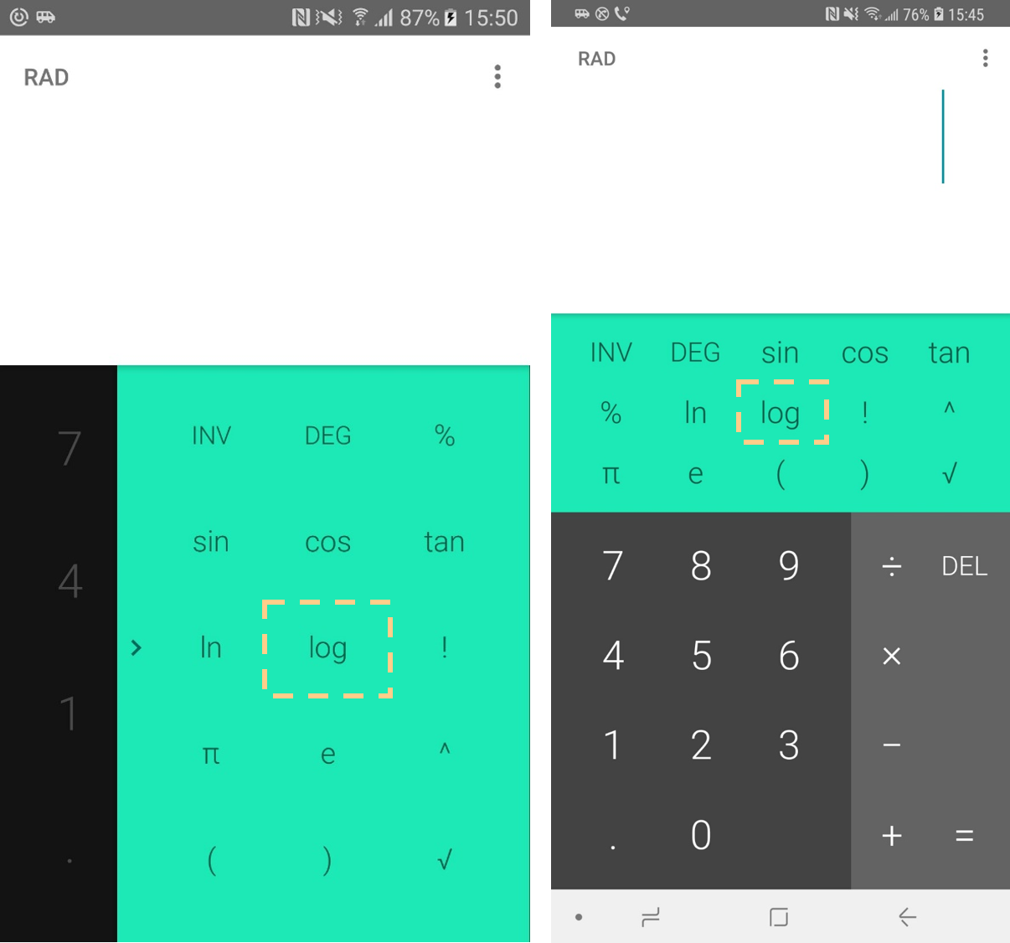
Evaluation of SARA
Record & Replay on Different Device
Main Causes of Failures
Inaccurate View Hierarchy ( Caused by UIAutomator2 )
Breaking Change of UI

Slide 21
Demo Video

Slide 22

Recording Phase
Self-replaying Phase
Replaying Phase
Developer/Testers
Replay Agent
Replay Agent
Recording Device
Recording Device
Replaying Devices

Slide 23
What is Record & Replay ?
Recording Phase
Replaying Phase
Developer/Testers
Replay Script
Recording Device
Replaying Devices

Slide 24
What is Record & Replay ?
Recording Phase
Replaying Phase
Developer/Testers
Replay Script
Recording Device
Replaying Devices

Slide 25
What is Record & Replay ?
Recording Phase
Replaying Phase
Developer/Testers
Replay Script
Recording Device
Replaying Devices

Slide 26
What is Record & Replay ?
Recording Phase
Replaying Phase
Developer/Testers
Replay Script
Recording Device
Replaying Devices

Slide 27
What is Record & Replay ?
Recording Phase
Replaying Phase
Developer/Testers
Replay Script
Recording Device
Replaying Devices

